Slide 1
Different approaches
Brute-Force Approach
Heuristic Search
Two-Player-Games Search
Interleaving Search

Slide 2
Informed (Heuristic) Search
Add domain-specific information to select the best path along which to continue searching
Define a heuristic function, h(n), that estimates the “goodness” of a node n.
Specifically, h(n) = estimated cost (or distance) of minimal cost path from n to a goal state.
The heuristic function is an estimate, based on domain-specific information that is computable from the current state description, of how close we are to a goal

Slide 3
Heuristic Search (cont…)
Heuristic Information
In order to solve larger problems, domain-specific knowledge must be added to improve search efficiency.
Information about the problem include
  the nature of states,
  cost of transforming from one state to another,
  and characteristics of the goals.
This information expressed in the form of heuristic evaluation function,
  f(n,g),
  a function of the nodes n and/or the goals g.

Slide 4
Uniform Cost Search
If there are costs attached to the edges and we want the lowest cost plan, we use uniform cost search
For each path on the agenda, we store the cost of the path.
When selecting a path to expand, select the one with the lowest cost
Returns the plan with the lowest cost
We consider the cost of each node is Uniform… So only cost of edge from Root is considered
Note: this is not a heuristic search method!

Slide 5
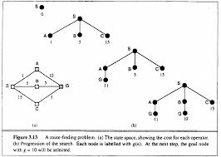

Slide 6
Heuristic Search (cont…)
Heuristic search techniques.
Best First Search
  Pure Heuristic Search
  Uniform Cost Search (Non heuristic)
Hill Climbing
A* algorithm
Iterative-Deepening A*
Depth-First Branch-And-Bound
Heuristic Path Algorithm
Recursive Best-First Search

Slide 7
Best First Search Algorithm:
OPEN: List of Unvisied nodes
Start with OPEN holding the initial state
Pick the best node on OPEN
Generate its successors
For each successor Do
  If it has not been generated before evaluate it add it to OPEN and record its parent
  If it has been generated before change the parent if this new path is better and in that case update the cost of getting to any successor nodes
If a goal is found or no more nodes left in OPEN, quit, else return to 2.

Slide 8
BFS
Step 1
A

Slide 9
BFS
Step 1
Step 2
A
A
B
C
5
D
1
3

Slide 10
BFS
Step 1
Step 2
Step 3
A
A
A
B
C
5
D
1
B
C
D
3
3
5
1
E
4
F
6
OPEN: A
OPEN:B,C,D
OPEN: B,C,E,F
1

Slide 11
BFS
Step 1
Step 2
Step 3
A
A
A
B
C
5
D
1
B
C
D
3
3
5
1
Step 4
E
4
F
A
6
B
C
5
D
1
OPEN: A
OPEN:B,C,D
OPEN: B,C,E,F
OPEN:C,E,F,G,H
3
G
H
E
4
F
6
5
6

Slide 12
BFS
Step 1
Step 2
Step 3
A
A
A
B
C
5
D
1
B
C
D
3
3
5
1
Step 4
Step 5
E
4
F
A
A
6
B
C
D
B
C
5
D
1
3
5
1
3
E
F
G
H
E
4
F
G
6
H
5
4
6
5
6
6
A
2
A
1

Slide 13
Pure Heuristic Search (PHS)
In a graph with cycles, multiple paths will be found to the same node, and the first path found may not be the shortest.
  When a shorter path is found to an open node, the shorter path is saved and the longer one is discarded.
  When a shorter path to a closed node is found, the node is invaded to open and the shorter path is associated with it.
  For Evaluation of the path the heuristics to reach the goal is used (h(x))
  It ignores the cost of the path so far to node n, it does not find optimal solutions.

Slide 14
PHS/BFS/UCS
UCS and PHS are all special cases of BFS
  UCS: F(n) = G(n) (Cost from Root)
  PHS: F(n) = H(n) (Cost of heuristic of the current state)

Slide 15
Heuristic Calculation
H(n) is a quantitative value of the node
  cost of the current state to Goal state
  Application dependent

Slide 16
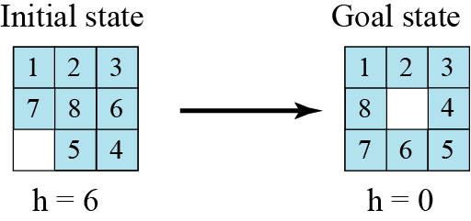
Heuristic Calculation(8-Puzzle)
Heuristic :
The number of misplaced tiles (not including the blank)
Notation: h(n) (n indicates the state id)

Slide 17
Heuristic Calculation(8-Puzzle) (cont)
Heuristic : The Manhattan Distance (not including the blank)
In this case, only the “3”, “8” and “1” tiles are misplaced, by 2, 3, and 3 squares respectively, so the heuristic function evaluates to 8.
3
2
8
1
2
3
Current State
Goal State
4
5
6
4
5
6
7
1
7
8
3
3
8
1
8
1
2 spaces
3 spaces
3 spaces

Slide 18
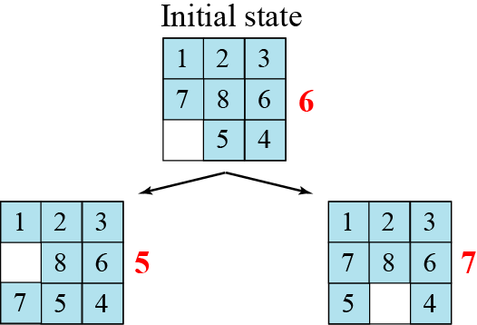
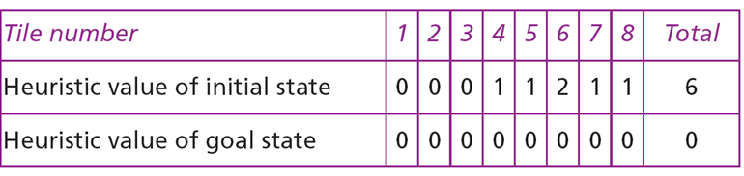
Complete solution for the 8 Puzzle problem

Slide 19
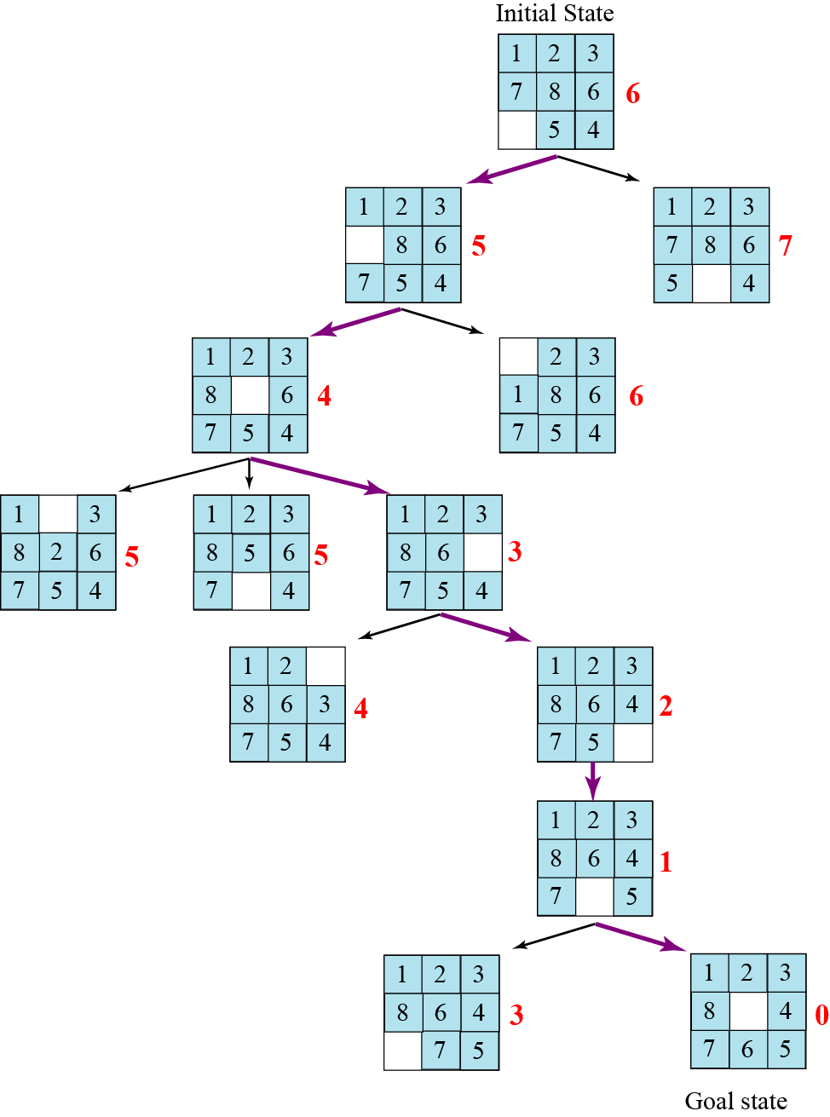
Heuristic search tree for solving the 8-puzzle

Slide 20
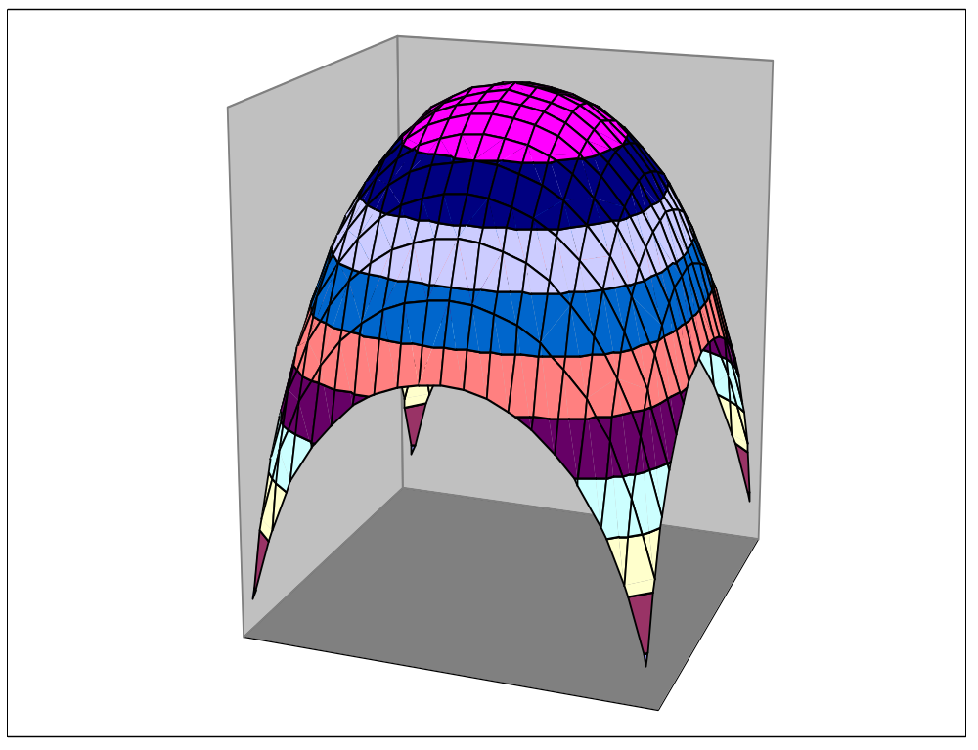
Hill Climbing

Slide 21
Hill Climbing - Algorithm
1. Pick a random point in the search space
2. Consider all the neighbors of the current state
3. Choose the neighbor with the best quality and move to that state
4. Repeat 2 thru 4 until all the neighboring states are of lower quality
5. Return the current state as the solution state

Slide 22
Hill Climbing
Is a variant of generate-and test in which feedback from the test procedure is used to help the generator decide which direction to move in search space.
The test function is augmented with a heuristic function that provides an estimate of how close a given state is to the goal state.
Computation of heuristic function can be done with negligible amount of computation.
Hill climbing is often used when a good heuristic function is available for evaluating states but when no other useful knowledge is available.

Slide 23
Simple Hill Climbing (Algorithm)
Evaluate the initial state.
If goal state
return the state
else
current-state = initial-state
Repeat until
  Until a solution is found
  OR Until there are no new operators left to be applied in the current state:
  Select an operator that has not yet been applied to the current state and apply it to produce a new state
  Evaluate the new state
    If it is the goal state, then return it and quit.
    If it is not a goal state but it is better than the current state, then make it the current state (First found better solution will be selected and will not check the next option).
    If it is not better than the current state, then continue in the loop.

Slide 24
Simple Hill Climbing
The key difference between Simple Hill climbing and Generate-and-test
  the use of evaluation function
  as a way to inject task specific knowledge into the control process.
Is one state better than another ?
  For this algorithm to work, precise definition and evaluation of state must be provided.

Slide 25
Given 8 Puzzle game
Start State Goal State
h = -4 h = 0
2
8
3
1
2
3
1
6
4
8
4
7
5
7
6
5

Slide 26
Hill climbing example (1)
2
8
3
1
2
3
start
1
6
4
h = -4
goal
8
4
h = 0
7
5
7
6
5
-5
-5
-2
2
8
3
1
2
3
1
4
h = -3
8
4
h = -1
7
6
5
7
6
5
-3
-4
2
3
2
3
1
8
4
1
8
4
h = -2
7
6
5
7
6
5
h = -3
-4
Heuristic : f(n) = -(number of tiles out of place)

Slide 27

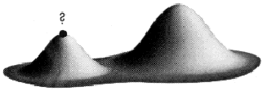
Local Maxima: Challenges of Hill-climbing
Local Maxima:
Local maximum as opposed to global maximum:
  Search is an iterative local procedure
  Good heuristics should provide some global look-ahead (at low computational cost)
a peak that is lower than the highest peak, so a suboptimal solution is returned

Slide 28
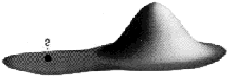
Plateaus : Challenges of Hill-climbing
Plateaus:
  the space has a broad flat region that gives the search algorithm no direction
  Result in random walk.

Slide 29
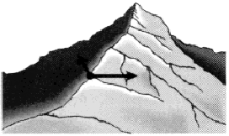
Ridge : Challenges of Hill-climbing
  Ridge:
  There are steep slopes and the search direction inot towards the top but towards the side
  slopes very gently toward a peak, so the search may oscillate from side to side

Slide 30
Remedy for the issues in Hill Climbing
In each of the previous cases (local maxima, plateaus & ridge),
  the algorithm reaches a point at which no progress is being made.
A solution is
  Random-restart hill-climbing
    where random initial states are generated,
    running each until it halts or makes no discernible progress.
    The best result is then chosen

Slide 31
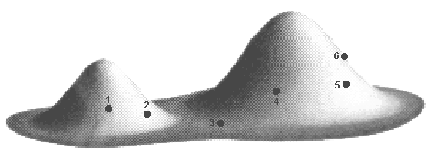
Random restart hill-climbing
Start different hill-climbing searches from random starting positions stopping when a goal is found
Save the best result from any search so far
If all states have equal probability of being generated, it is complete with probability approaching 1 (a goal state will eventually be generated).
Finding an optimal solution becomes the question of sufficient number of restarts
Surprisingly effective, if there aren’t too many local maxima or plateaux
Notes:
There are lots of varients of hill climbing.

Slide 32
Interesting Comparison
Uniform Cost
Measures the cost to each node.
Is optimal and complete!
Can be very slow.
Hill Climbing
Estimates how far away the goal is.
Is neither optimal nor complete.
Can be very fast.
Can we combine them to create an optimal and complete algorithm that is also very fast?

Slide 33
Uniform Cost Search
Enqueue nodes in order of cost
5
2
5
2
5
2
1
7
1
7
4
5
Intuition: Expand the cheapest node. Where the cost is the path cost g(n)
Hill Climbing Search
Enqueue nodes in order of estimated distance to goal
17
19
17
19
17
19
16
14
16
14
13
15
Intuition: Expand the node you think is nearest to goal. Where the estimate of distance to goal is h(n)

Slide 34
Steepest-Ascent Hill Climbing
This is a variation of simple hill climbing which considers all the moves from the current state and selects the best one as the next state.
Also known as Gradient search

Slide 35
Algorithm: Steepest-Ascent Hill Climbing
Evaluate the initial state.
  If it is also a goal state, then return it and quit. Otherwise, continue with the initial state as the current state.
Loop until a solution is found or until a complete iteration produces no change to current state:
  Let SUCC be a state such that any possible successor of the current state will be better than SUCC
  For each operator that applies to the current state do:
    Apply the operator and generate a new state
    Evaluate the new state. If is is a goal state, then return it and quit. If not, compare it to SUCC. If it is better, then set SUCC to this state. If it is not better, leave SUCC alone.
  If the SUCC is better than the current state, then set current state to SUCC,

Slide 36
BFS and Steepest ascent hill climbing
At each step of the BFS search process, we select the most promising of the nodes we have generated so far using appropriate heuristic function and then expand the chosen node by using the rules to generate its successors
BFS is Similar to Steepest ascent hill climbing with two exceptions:
  In hill climbing, one move is selected and all the others are rejected, never to be reconsidered. This produces the straight-line behavior that is characteristic of hill climbing.
  In BFS, one move is selected, but the others are kept around so that they can be revisited later if the selected path becomes less promising.
  Further, the best available state is selected in the BFS, even if that state has a value that is lower than the value of the state that was just explored.
  This contrasts with hill climbing, which will stop if there are no successor states with better values than the current state.

Slide 37
Defining Heuristic Function
The heuristic function h(N) ≥ 0 estimates the cost to go from STATE(N) to a goal state
Its value is independent of the current search tree; it depends only on STATE(N) and the goal test GOAL?
Example:
h₁(N) = number of misplaced numbered tiles = 6
[Why is it an estimate of the distance to the goal?]
5
8
1
2
3
4
2
1
4
5
6
7
3
6
7
8
STATE(N)
Goal state

Slide 38
Other Examples
  h₁(N) = number of misplaced numbered tiles = 6
  h₂(N) = sum of the (Manhattan) distance of every numbered tile to its goal position
  = 2 + 3 + 0 + 1 + 3 + 0 + 3 + 1 = 13
  h₃(N) = sum of permutation inversions
  = n₅ + n₈ + n₄ + n₂ + n₁ + n₇ + n₃ + n₆
  = 4 + 6 + 3 + 1 + 0 + 2 + 0 + 0
  = 16
5
8
1
2
3
4
2
1
4
5
6
7
3
6
7
8
STATE(N)
Goal state

Slide 39
8-Puzzle
f(N) = h(N) = number of misplaced numbered tiles
3
3
4
5
3
4
2
4
2
1
3
3
0
4
5
4
The white tile is the empty tile

Slide 40
8-Puzzle
f(N) = h(N) = Σ (Manhattan) distances of numbered tiles
to their goals
6
5
2
5
2
1
4
3
0
4
6
5

Slide 41
Greedy Search
f(N) = h(N) → greedy best-first

Slide 42
Greedy Search
f(N) = h(N) → greedy best-first
Is it complete?
  If we eliminate endless loops, yes
Is it optimal?

Slide 43
More informed search
We kept looking at nodes closer and closer to the goal, but were accumulating costs as we got further from the initial state
Our goal is not to minimize the distance from the current head of our path to the goal, we want to minimize the overall length of the path to the goal!
Let g(N) be the cost of the best
path found so far between the initial
node and N
f(N) = g(N) + h(N)

Slide 44
Can we Prove Anything?
If the state space is finite and we avoid repeated states, the search is complete, but in general is not optimal
If the state space is infinite (loops are not avoided), the search is in general not complete

Slide 45
More informed search
We kept looking at nodes closer and closer to the goal, but were accumulating costs as we got further from the initial state
Our goal is not to minimize the distance from the current head of our path to the goal, we want to minimize the overall length of the path to the goal!
Let g(N) be the cost of the best
path found so far between the initial
node and N
f(N) = g(N) + h(N)

Slide 46
How to construct f?
Typically, f(N) estimates:
  either the cost of a solution path through N
    Then f(N) = g(N) + h(N), where
      g(N) is the cost of the path from the initial node to N
      h(N) is an estimate of the cost of a path from N to a goal node
  or the cost of a path from N to a goal node
    Then f(N) = h(N) → Greedy best-search
But there are no limitations on f. Any function of your choice is acceptable.
But will it help the search algorithm?

Slide 47
How to construct f? (Revision)
Typically, f(N) estimates:
  either the cost of a solution path through N
    Then f(N) = g(N) + h(N), where
      g(N) is the cost of the path from the initial node to N
      h(N) is an estimate of the cost of a path from N to a goal node
  or the cost of a path from N to a goal node
    Then f(N) = h(N)
But there are no limitations on f. Any function of your choice is acceptable.
But will it help the search algorithm?
Heuristic function

Slide 48
A* Search
Evaluation function:
f(N) = g(N) + h(N)
where:
  g(N) is the cost of the best path found so far to N
  h(N) is an admissible heuristic
Then, best-first search with this evaluation function is called A* search
Important AI algorithm developed by Fikes and Nilsson in early 70s. Originally used in Shakey robot.

Slide 49
A* Algorithm
BFS is a simplification of A* Algorithm
Presented by Hart et al
Algorithm uses:
  f’: addition of two heuristic evaluations, g and h’
  g : The function g is a measure of the cost of getting from initial state to the current node.
  h’ : The function h’ is an estimate of the additional cost of getting from the current node to a goal state.
  OPEN
  CLOSED

Slide 50
A* Algorithm
Initially
  OPEN = {start Node},CLOSED = { }
  g(Start Node} = 0
  h’(Start Node) = calculate
  f’(Start Node) = h’+0 = h’
Until a goal node is found, repeat
  If there are no nodes on OPEN, report failure
  Otherwise pic the BESTNODE node from OPEN with the lowest f’
  Remove it from OPEN and put it in CLOSED.
  If the BESTNODE is a goal state so exit and report a solution.
  Else generate the successors of BESTNODE and add in the OPEN list

Slide 51
A* Algorithm ( contd)
For each of the SUCCESSOR, do the following:
Set SUCCESSOR to point back to BESTNODE. These backwards links will make it possible to recover the path once a solution is found.
Compute g(SUCCESSOR) = g(BESTNODE) + the cost of getting from BESTNODE to SUCCESSOR
See if SUCCESSOR is the same as any node on OPEN. If so call the node OLD.
If SUCCESSOR was not on OPEN, see if it is on CLOSED. If so, call the node on CLOSED OLD and add OLD to the list of BESTNODE’s successors.
If SUCCESSOR was not already on either OPEN or CLOSED, then put it on OPEN and add it to the list of BESTNODE’s successors. Compute f’(SUCCESSOR) = g(SUCCESSOR) + h’(SUCCESSOR)

Slide 52
Observations about A*
Role of g function: This lets us choose which node to expand next on the basis of not only of how good the node itself looks, but also on the basis of how good the path to the node was.
h’, the distance of a node to the goal.If h’ is a perfect estimator of h, then A* will converge immediately to the goal with no search.

Slide 53
How fast is A*?
A* is the fastest search algorithm. That is, for any given heuristic, no algorithm can expand fewer nodes than A*.
How fast is it? Depends of the quality of the heuristic.
If the heuristic is useless (ie h(n) is hardcoded to equal 0 ), the algorithm degenerates to uniform cost.
If the heuristic is perfect, there is no real search, we just march down the tree to the goal.
Generally we are somewhere in between the two situations above. The time taken depends on the quality of the heuristic.

Slide 54
Completeness & Optimality of A*
Claim 1: If there is a path from the initial to a goal node, A* (with no removal of repeated states) terminates by finding the best path, hence is:
  complete
  optimal
requirements:
  0 < ε ≤ c(N,N’)
  Each node has a finite number of successors

Slide 55
8-Puzzle
f(N) = g(N) + h(N)
with h(N) = number of misplaced numbered tiles
3+3
1+5
2+3
3+4
5+2
0+4
3+2
4+1
1+3
2+3
5+0
3+4
1+5
2+4

Slide 56
Robot Navigation

Slide 57
Robot Navigation
f(N) = h(N), with h(N) = Manhattan distance to the goal
8
7
6
5
4
3
2
3
4
5
6
7
5
4
3
5
6
3
2
1
0
1
2
4
7
6
5
8
7
6
5
4
3
2
3
4
5
6

Slide 58
Robot Navigation
f(N) = h(N), with h(N) = Manhattan distance to the goal
8
7
6
5
4
3
2
3
4
5
6
7
5
4
3
5
6
3
2
1
0
0
1
2
4
7
What happened???
7
6
5
8
7
6
5
4
3
2
3
4
5
6

Slide 59
Robot Navigation
f(N) = g(N)+h(N), with h(N) = Manhattan distance to goal
8+3
8+3
7+4
7+4
6+5
6+3
5+6
5+6
4+7
4+7
3+8
3+8
2+9
8
7
6
5
4
3
2+9
3+10
2
3
4
5
6
7+2
7+2
5+6
4+7
3+8
7
5
4
3+8
3
5
6+1
2+9
6+1
2+9
1+10
6
3
2
1+10
0+11
1
0
1
2
4
7+0
7+0
6+1
7
6+1
6
5
8+1
8+1
7+2
7+2
6+3
6+3
5+4
5+4
4+5
4+5
3+6
3+6
2+7
8
7
6
5
4
3
2+7
3+8
2
3
4
5
6

Slide 60
Avoiding Repeated States in A*
If the heuristic h is consistent, then:
Let CLOSED be the list of states associated with expanded nodes
When a new node N is generated:
  If its state is in CLOSED, then discard N
  If it has the same state as another node in the fringe, then discard the node with the largest f

Slide 61
Complexity of Consistent A*
Let s be the size of the state space
Let r be the maximal number of states that can be attained in one step from any state
Assume that the time needed to test if a state is in CLOSED is O(1)
The time complexity of A* is O(s r log s)

Slide 62
Heuristic Accuracy
h(N) = 0 for all nodes is admissible and consistent. Hence, breadth-first and uniform-cost are particular A* !!!
Let h1 and h2 be two admissible and consistent heuristics such that for all nodes N: h1(N) ≤ h2(N).
Then, every node expanded by A* using h2 is also expanded by A* using h1.
h2 is more informed than h1

Slide 63
Iterative Deepening A* (IDA*)
Use f(N) = g(N) + h(N) with admissible and consistent h
Each iteration is depth-first with cutoff on the value of f of expanded nodes

Slide 64
8-Puzzle
f(N) = g(N) + h(N)
with h(N) = number of misplaced tiles
4
Cutoff=4
6

Slide 65
8-Puzzle
f(N) = g(N) + h(N)
with h(N) = number of misplaced tiles
4
Cutoff=4
4
6
6

Slide 66
8-Puzzle
f(N) = g(N) + h(N)
with h(N) = number of misplaced tiles
4
Cutoff=4
4
5
6
6

Slide 67
8-Puzzle
f(N) = g(N) + h(N)
with h(N) = number of misplaced tiles
5
4
Cutoff=4
4
5
6
6

Slide 68
8-Puzzle
f(N) = g(N) + h(N)
with h(N) = number of misplaced tiles
6
5
4
Cutoff=4
4
5
6
6

Slide 69
8-Puzzle
f(N) = g(N) + h(N)
with h(N) = number of misplaced tiles
4
Cutoff=5
6

Slide 70
8-Puzzle
f(N) = g(N) + h(N)
with h(N) = number of misplaced tiles
4
Cutoff=5
4
6
6

Slide 71
8-Puzzle
f(N) = g(N) + h(N)
with h(N) = number of misplaced tiles
4
Cutoff=5
4
5
6
6

Slide 72
8-Puzzle
f(N) = g(N) + h(N)
with h(N) = number of misplaced tiles
4
Cutoff=5
4
5
7
6
6

Slide 73
8-Puzzle
f(N) = g(N) + h(N)
with h(N) = number of misplaced tiles
4
5
Cutoff=5
4
5
7
6
6

Slide 74
8-Puzzle
f(N) = g(N) + h(N)
with h(N) = number of misplaced tiles
4
5
5
Cutoff=5
4
5
7
6
6

Slide 75
8-Puzzle
f(N) = g(N) + h(N)
with h(N) = number of misplaced tiles
4
5
5
Cutoff=5
4
5
7
6
6

Slide 76
Iterative Deepening A* (IDA*) Search
Solve the space problem of breadth-first search
iterative deepening A* (IDA*) eliminates the memory constraints of A* search algorithm without sacrificing solution optimality.
Each iteration of the algorithm is a depth-first search that keeps track of the cost, f(n) = g(n) + h(n), of each node generated.

Slide 77
Iterative Deepening A* (IDA*) Search
Solve the space problem of breadth-first search
iterative deepening A* (IDA*) eliminates the memory constraints of A* search algorithm without sacrificing solution optimality.
Each iteration of the algorithm is a depth-first search that keeps track of the cost, f(n) = g(n) + h(n), of each node generated.
As soon as a node is generated whose cost exceeds a threshold for that iteration,
  its path is cut off,
  and the search backtracks before continuing.
This threshold
  starts at the estimate of the cost at the initial state,
  and increases for each iteration of the algorithm.

Slide 78
Iterative Deepening A* (IDA*) Search
Solve the space problem of breadth-first search
iterative deepening A* (IDA*) eliminates the memory constraints of A* search algorithm without sacrificing solution optimality.
Each iteration of the algorithm is a depth-first search that keeps track of the cost, f(n) = g(n) + h(n), of each node generated.
As soon as a node is generated whose cost exceeds a threshold for that iteration,
  its path is cut off,
  and the search backtracks before continuing.
This threshold
  starts at the estimate of the cost at the initial state,
  and increases for each iteration of the algorithm.
At each iteration,
  the threshold used for the next iteration is the minimum cost of all values that exceeded the current threshold.
  For each successive iteration it is increased to the total cost of the lowest-cost node that was pruned during the previous iteration.
The algorithm terminates when a goal state is reached
  whose total cost does not exceed the current threshold

Slide 79
https://www.cs.princeton.edu/courses/archive/spring18/cos226/assignments/8puzzle/index.html
http://www.cs.ubbcluj.ro/~csatol/log_funk/prolog/slides/7-search.pdf (Using PROLOG)

